Slide 1
WELCOME

Slide 2
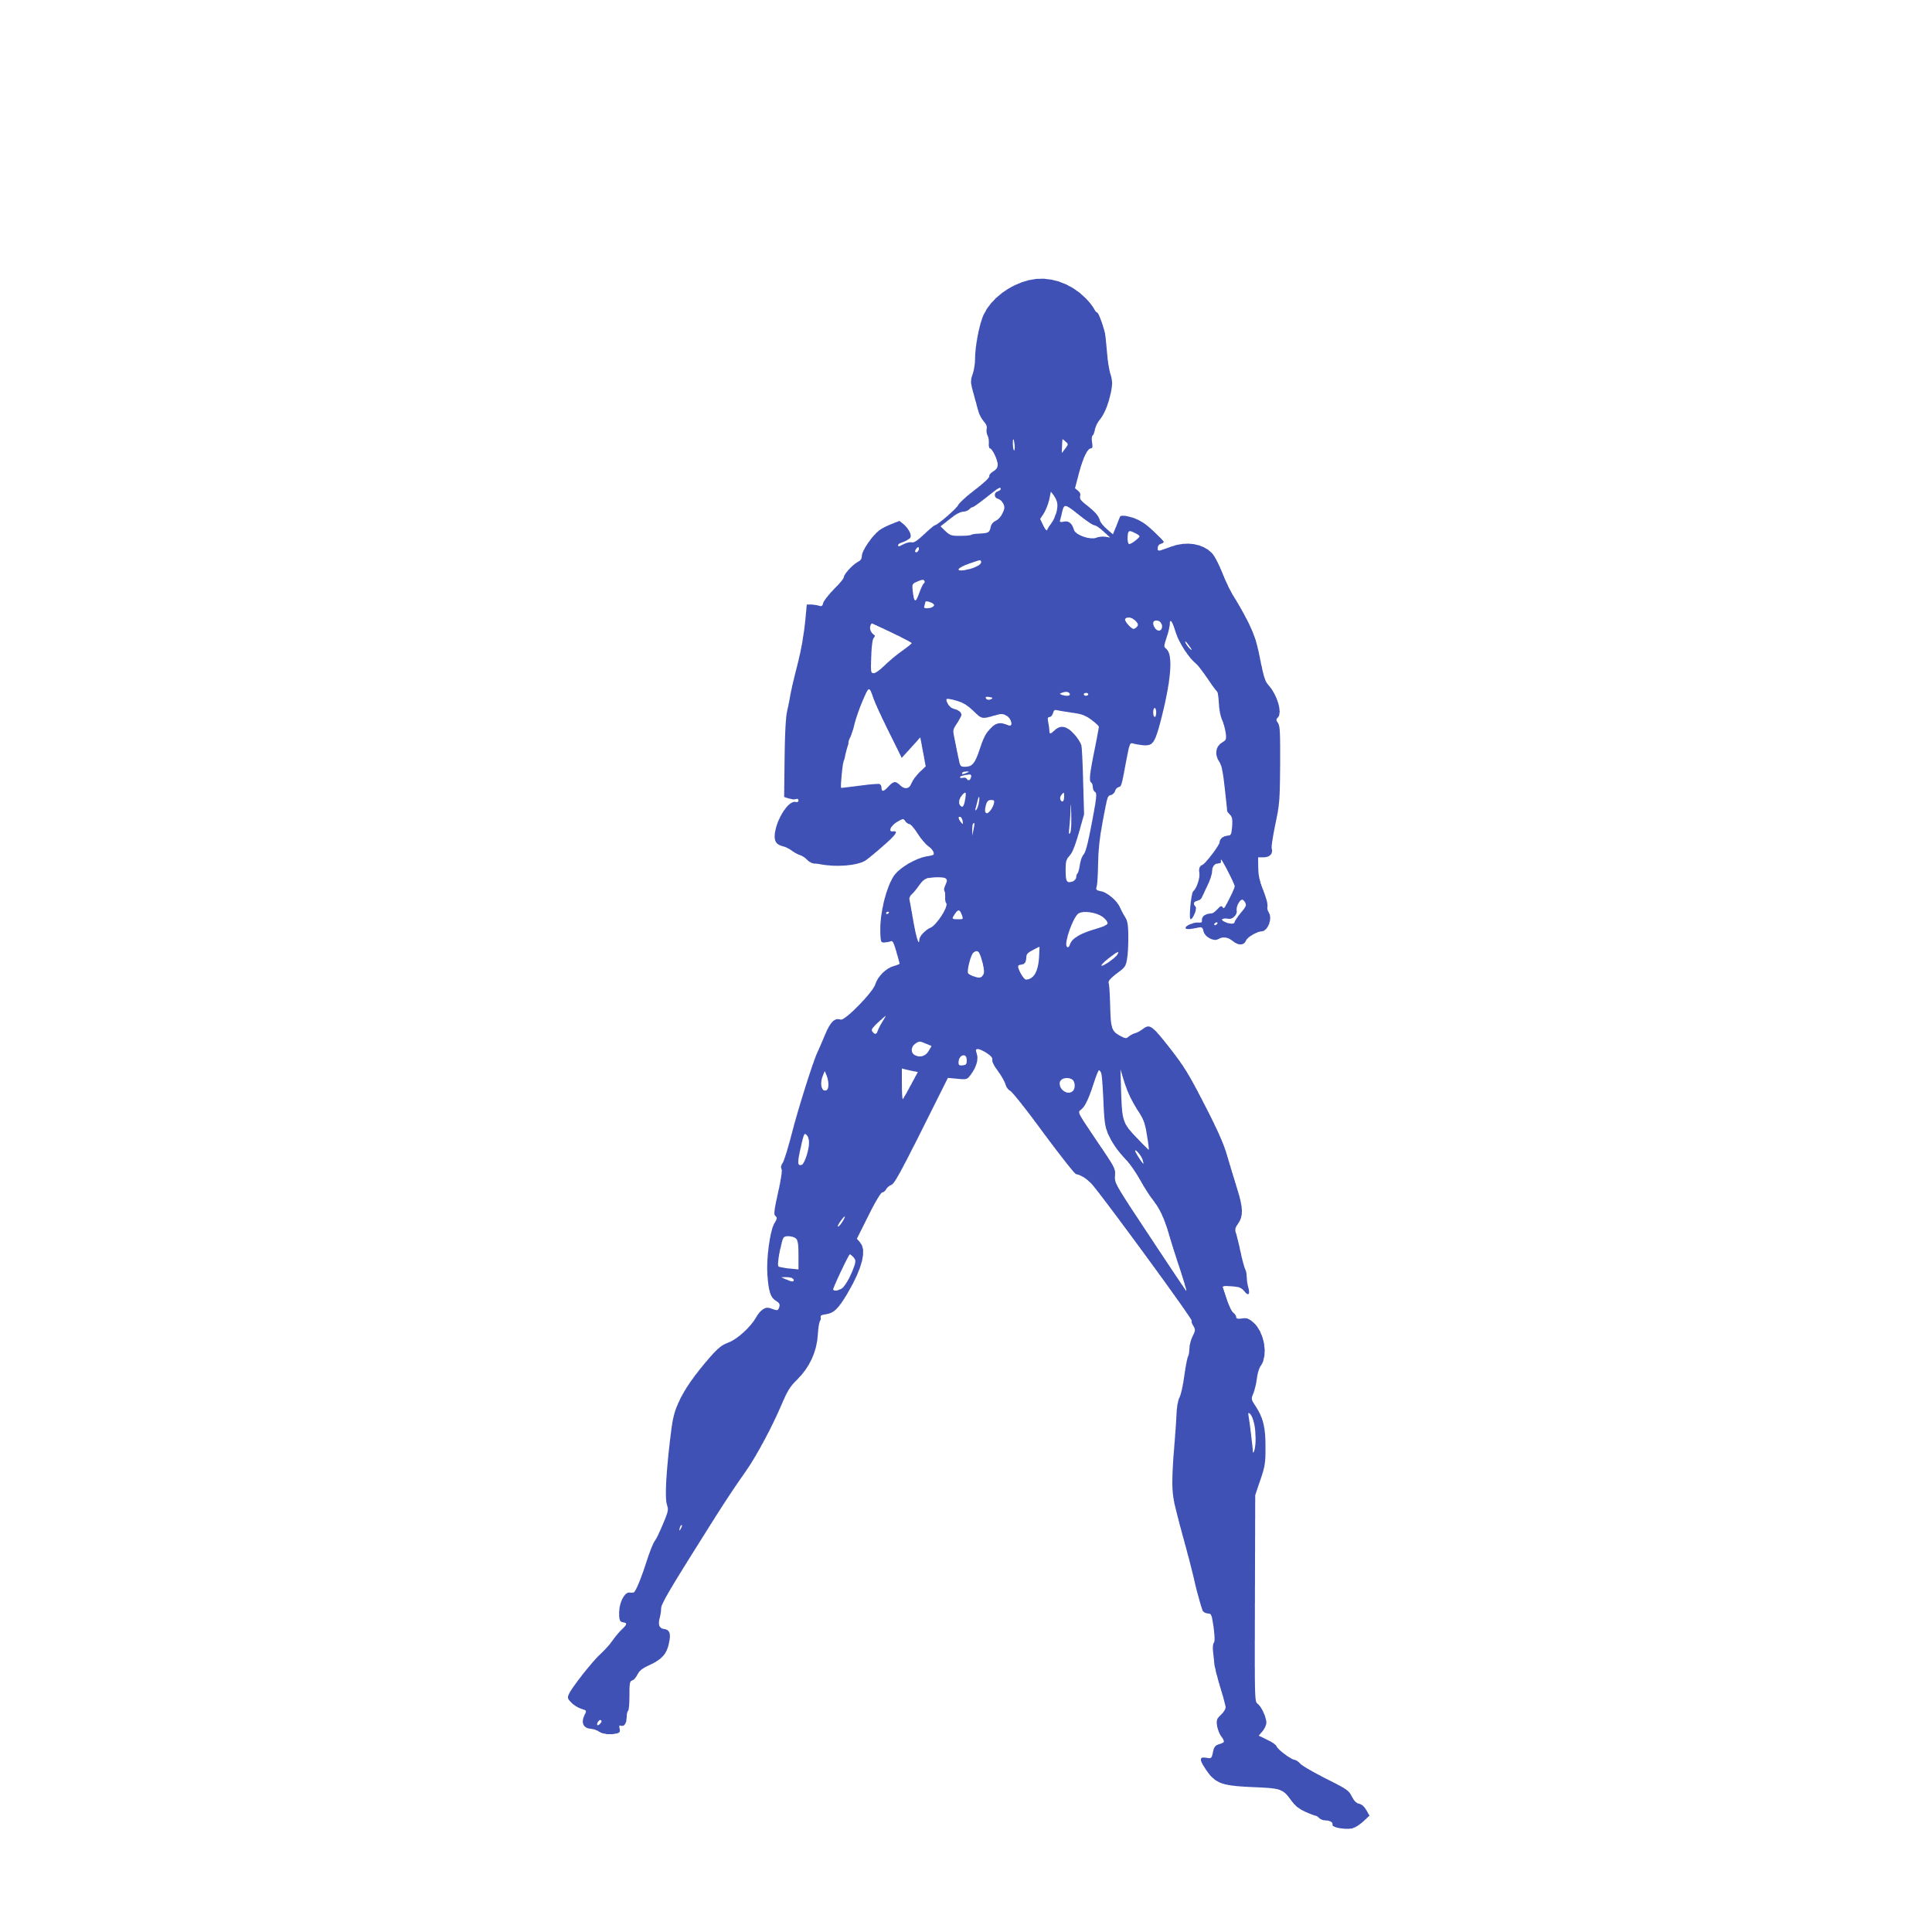
AI-Powered Workout Assistance
Introducing a revolutionary AI-based fitness app. Achieve your fitness goals and earn rewards. All you need is your mobile camera. No expensive equipment is required. Experience the future of fitness today.
BY:Keerthidharan.P
3ed year/CSBS
Mailam Engineering College

Slide 3
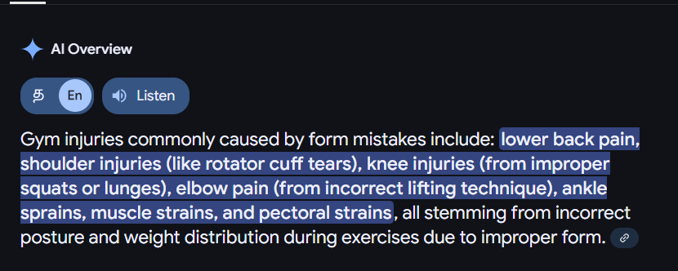
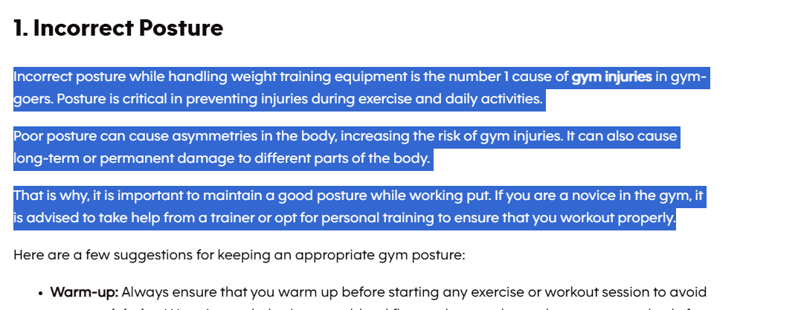
Targeted Problem

Slide 4
Reduce Injuries with AI Guidance
Real-Time Form Correction
Mobile Camera Only
Our AI provides instant feedback. Correct your form in real time.
Use your mobile camera. No expensive gym equipment is needed.
Minimize your risk of injury during workouts. Get personalized feedback. Exercise smarter, not harder.

Slide 5
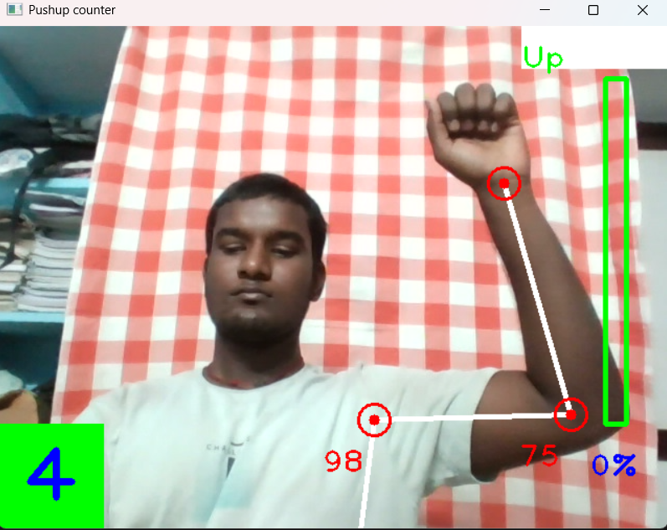
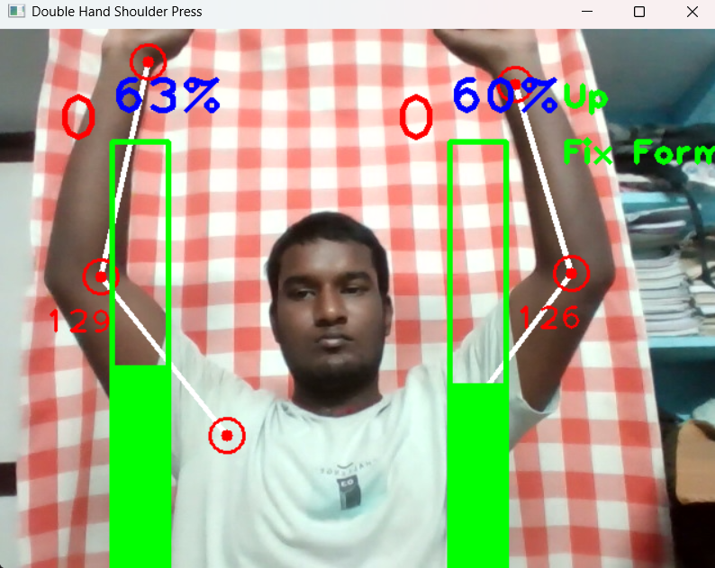
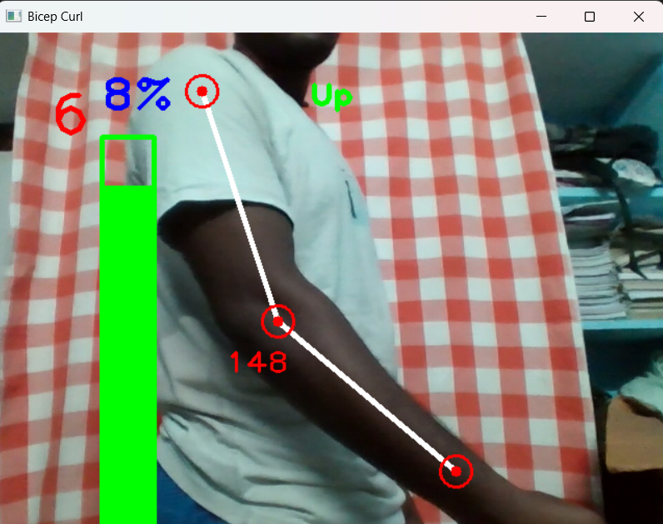
Project Demo Picture
Single Hand Shoulder Press
Double Hand /Shoulder Press
Bicep Curl

Slide 6
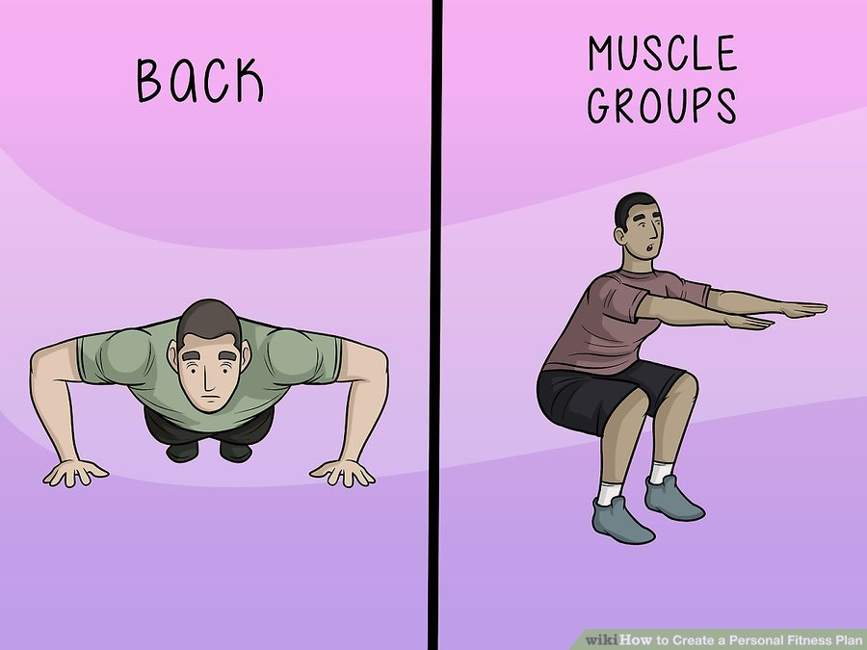



Personalized Fitness Plans
Understand your goals.
Analyze performance.
Tailored workouts for every user.
Every fitness plan is tailored just for you. Maximize your results.

Slide 7
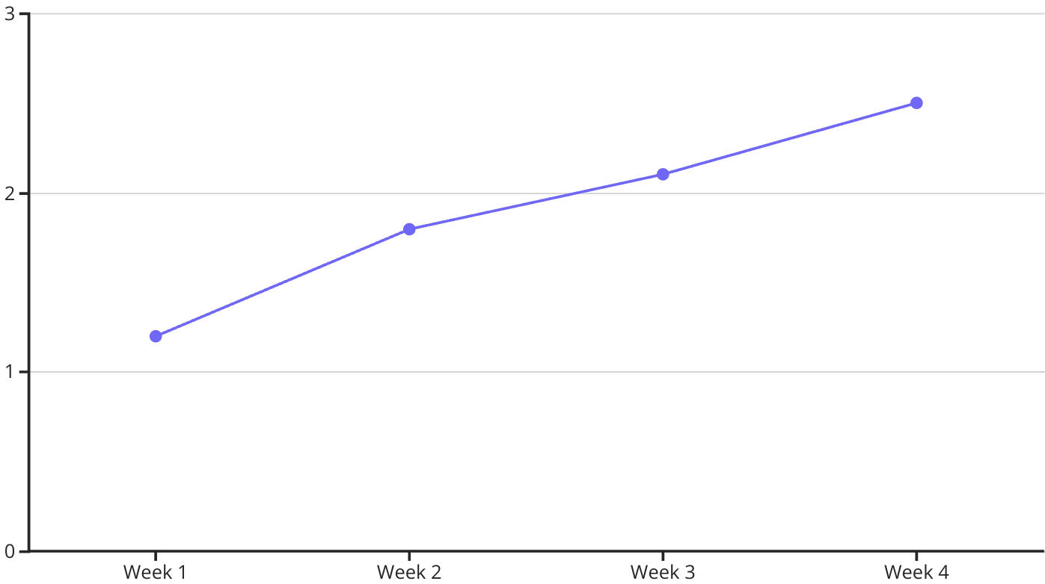
Track Your Progress
Visualize your fitness journey. Track metrics. See real results.

Slide 8

Community & Support
Connect
Share
Join our community forum.
Share your progress and support.
Motivate
Get motivated by others.
Stay motivated. Find friends. Achieve more together.

Slide 9
Revenue Model

Slide 10
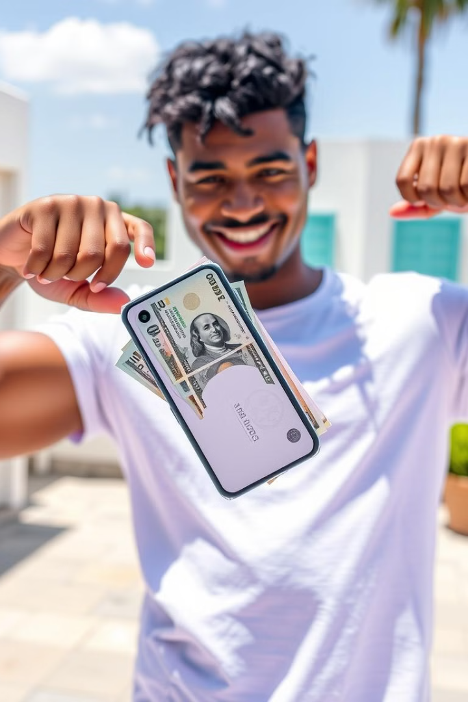
The Perfect Combination 💪💸
1
Health
Improve your fitness. Reduce injuries. Gain confidence.
2
Wealth
Earn money effortlessly. Monetize rest periods. Supplement income.
Experience a holistic approach to well-being. Prioritize both your health and wealth. Join the fitness revolution.

Slide 11
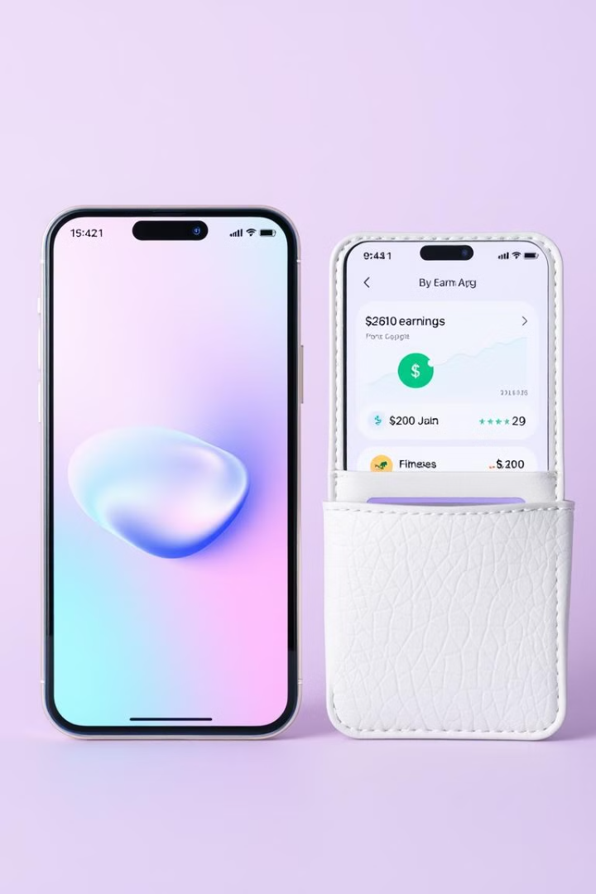




Earn Money During Rest Breaks 💸
Workout
Complete your workout sets.
Rest
Take a short break.
Watch Ads
Watch a short advertisement.
Earn
Earn money during your rest.
Monetize your downtime. Turn rest into rewarding moments. It’s Health + Wealth 💪💸

Slide 12
Impact And ROI Period

Slide 13
What’s the need of Investment?

Slide 14

Key Takeaways & Next Steps
Download
Earn
Download the app.
Earn rewards as you progress.
1
2
3
4
Start
Transform
Start your personalized fitness journey.
Transform your life with Health + Wealth 💪💸
Join the AI-powered fitness revolution. Unlock your full potential.

Slide 15
“THIS IS A BASE OF THE AI BASED VIRTUAL GYM”

Slide 16

ANY QUESTIONS?

Slide 17
THANKING YOU

